Slide 1



CraditOne Proposed Project Framework
Maral Jamali
Data Scientist at Guido Analytics

Slide 2

Overview
Reviewing the project goal
Collect and manage data
Model Building & Performance Evaluation
Known issues and limitations
Project Deliverables

Slide 3

Project Goal
To understand customers’ behavior and identify characteristics of ‘high-risk’ customers.

Slide 4

Data Collection and Management
Data: CreditOne Available Historical Data
Data Quality: Good
Expected Outcome: identifying high-risk customers’ sex, age, income level, etc.
Predicting where default payment next month = 1 based on the existing

Slide 5
Data Modeling
Using Classification algorithms like:
Random Forest
Decision Tree
KNN
SVM
Will apply these models on the available creditOne dataset and identify the most reliable one. Confidence level will be evaluated based on:
Kappa
Accuracy

Slide 6
Known Issues & Limitations
Issue | Our Solution
Missing Values | Requires further investigation. Either excluding the records from the analysis or using mean/average.
Dataset has 2 Header rows | Removing the first row and using the second row as the header
Unclear information in the dataset | Seeking clarification and asking for a high level dataset description from the stakeholders

Slide 7
Data Science FrameWork
Data Science Framework
Identify Project Goal
Data Collection
Data Exploration
Data Preparation/feature selection
Data Modeling
Model Evaluation & Optimization
Prediction
Visualization
Findings Presentations

Slide 8
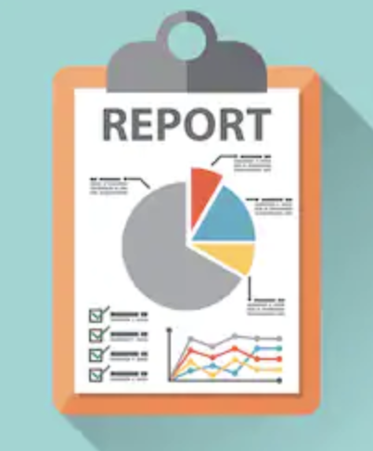

Project Deliverables
Non-Technical Report
Presentation

Slide 9


